Slide 1


Recog

Slide 2
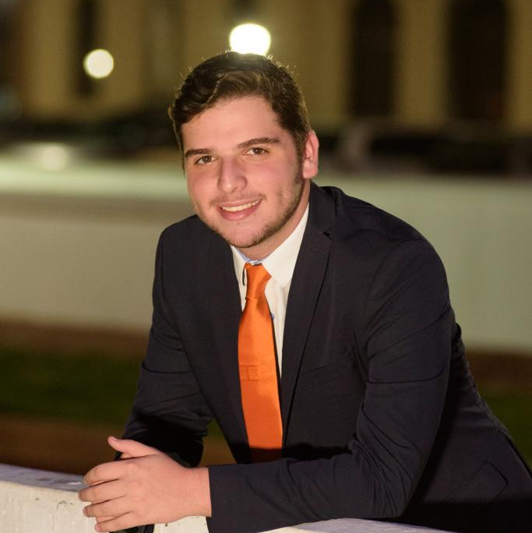
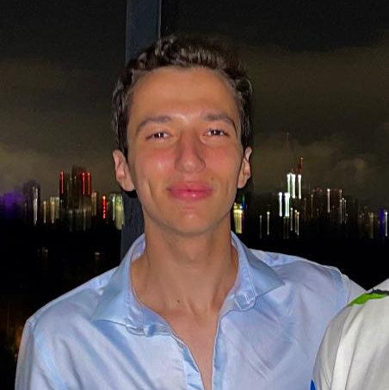
Whatever INC Team
Manuel Segimón Plana Project/Specification Lead
Jakob Zolkos Technical Lead
Joel Akerman Documentation Lead
Axel S. Toro Vega Interface Lead
Taha Ababou Project Lead

Slide 3
Program Structure
User Interface
Programmed in Kotlin
App Back End
Programmed in Kotlin
Server Program
Runs on Flask

Slide 4
1.
Server Side
Interaction with Google Cloud

Slide 5
Why Google Cloud Vision
Cheap (Free first few thousand calls)
Easy to implement
Well organized json ouput
We also considered using:
Amazon Rekogintion
IBM Watson Visual Recognition

Slide 6
Main Process of Server Program
Recieve Base64 and Dencode Image, Save and Enchance Image
Send Image to Google Cloud API and Convert Response
Generate Output String and Pass it Back to The App

Slide 7
Server Program Function Calls
Wait for call from app in flask. When called dencode base64 image. Then save image and pass its path to main function.
Pass path to GetObjects().
This converts Googles objects to our custom Object class. Then returns all of them as a list.
Back in the main the string that will be passed back to the user is generated.
1
3
5
2
4
6
Pass the path to enhance().
This edits the image color values using Pillow and saves it back to path.
GetObjects() first calls FIndObjects().
This call the Google API and retuns a list of Googles object type.
Finaly, back in the flask server. The generated string is then passed back to the app.

Slide 8
Object Class
Member Variables
objectType (What it is)
confidence (Percentage score of sertainty)
vertices (list of normalized vertices)
GetRelativePositions()
This function finds the normalized horizontal center of the object.
Then it returns the direction of the object relative to the user.
Other Member Functions
GetName(), returns objectType
HasGoodConfidence(), this returns true if the confidence is over 50%

Slide 9
Example Output of Server Program
Output of GetObjects()
objectType | confdence | verticies[0] | verticies[1] | verticies[2] | verticies[3]
Couch | 0.9738 | (0.12, 0.57) | (0.25, 0.89) | (0.12, 0.89) | (0.25, 0.57)
Chair | 0.4728 | (0.75, 0.20) | (0.96, 0.56) | (0.75, 0.56) | (0.96, 0.20)
Server Output
“There is a Couch to your slight right. There is an unknown object to your right.”

Slide 10
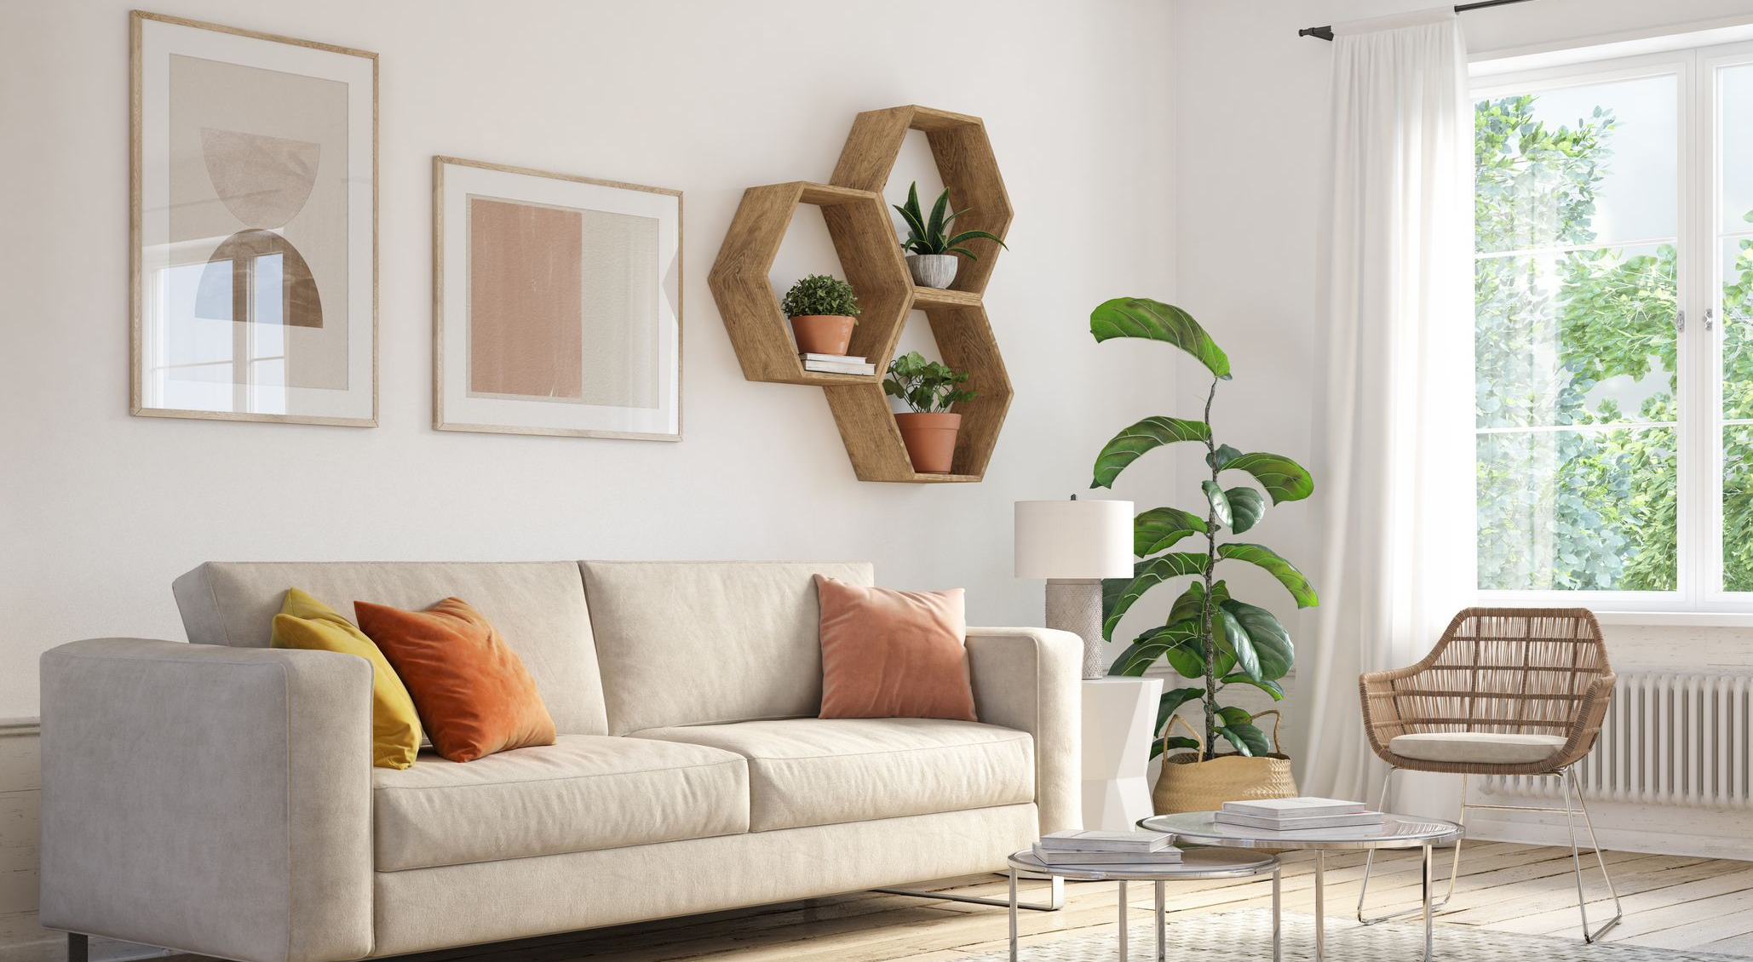
This was one of the main images used in testing the server.
More than 20 images were used.

Slide 11
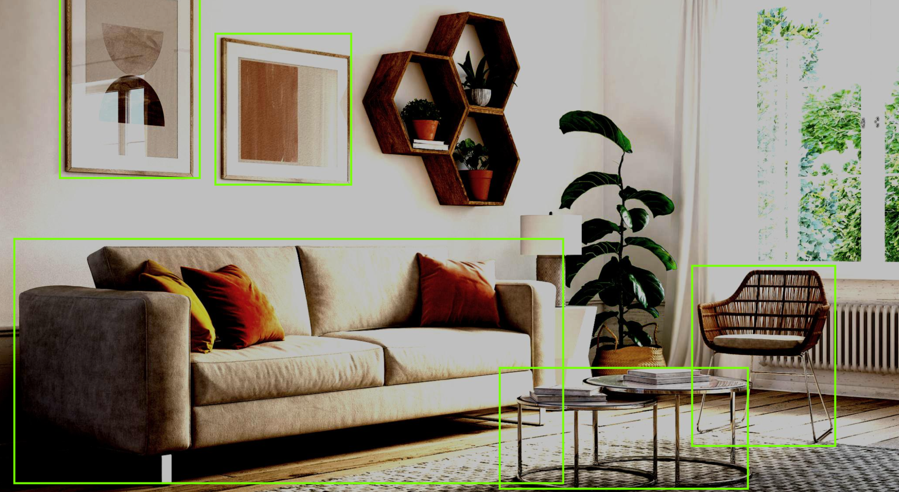
This is what the image looks like after enhancement.
It also shows the objects found.

Slide 12
Server Response Time (avg 11 seconds)
France (Server is here)
Boston (We are here)

Slide 13
2. App Back End
Sending Image to Server

Slide 14
Why Android and Kotlin
Android was chosen because most of our developers use it on their phones
Kotlin is now the main language of Android Studio, which is the main tool in android app development
We also considered developing in iOS, but it was just possible for some of our developers

Slide 15
Main Process of App Back End
Take a Picture Every X Seconds and Encode it to Base64
Send Base64 String to Server and Await Output String Response
Readout the Generated Output String to User

Slide 16
Back End Program Fucntion Calls
base64encoded
Declared as public string
onImageAvailable() captures camera frames at a very high frequency.
The base64 string generated in processImage() is constantly being assigned to base64encoded.
ConnectToServer() also receives the server response
1
3
5
2
4
6
Then processImage() convertes them to bitmaps, then to base64.
Every X number of seconds getImageString() sends base64encoded to the server using ConnectToServer().
The server response is then delivered to the user using text-to-speech

Slide 17
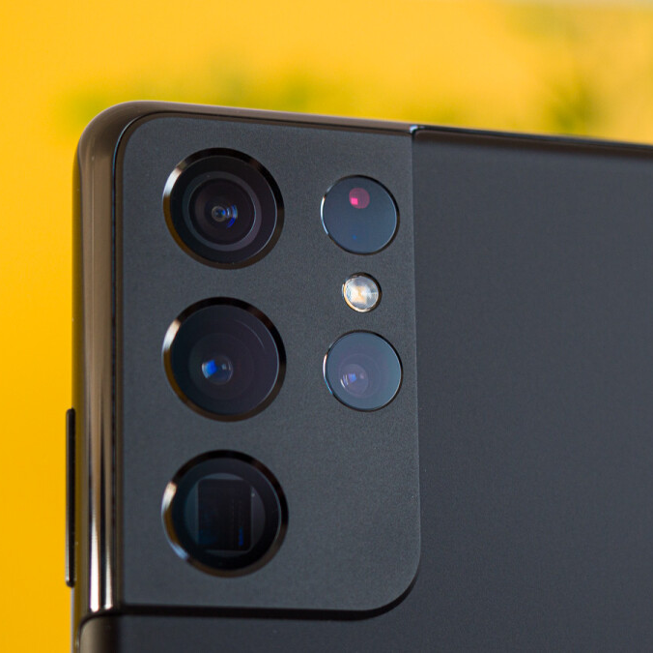
onImageAvailable() Function
To make the processImage function we used code from a repo created by hamza372 called “FramesOfLiveFeedKotlin”
https://github.com/hamza372/FramesOfLiveFeedKotlin

Slide 18
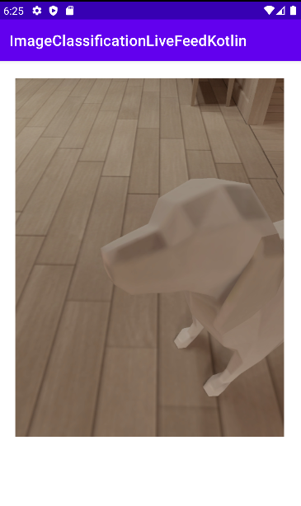
Example Output of Back End Program
Text To Speech Output
"There is a sculpture to your right.”

Slide 19
3.
App UI
Interaction with User

Slide 20
Design Criteria
Minmalistic Design
Easy to use and understand
Little to no user interaction to get app working
We need it to be simple and require no interaction because that way it is easier for vision impared people to use.

Slide 21
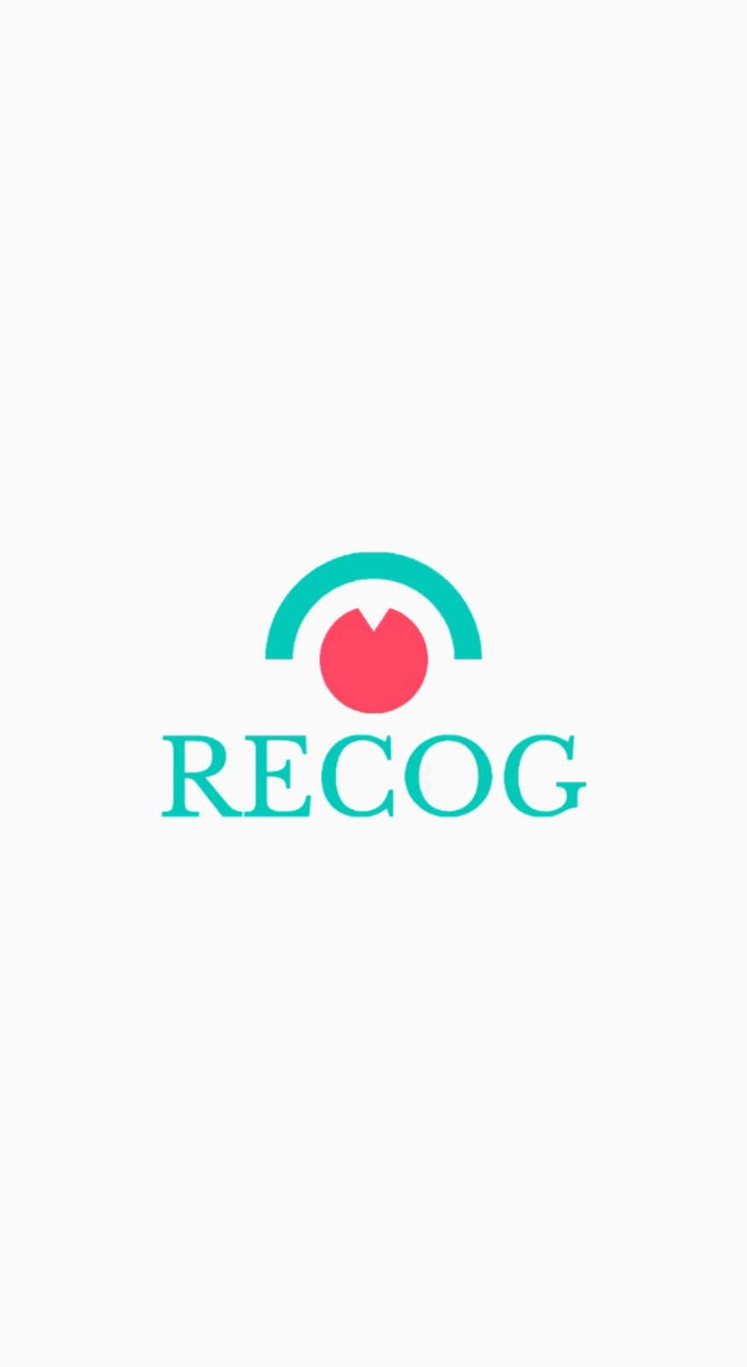
Splash Screen
For the splash screen we only wanted a simple and minimalistic design.
We feel that the simple addition of the logo with the name of the app achives this perfectly.

Slide 22
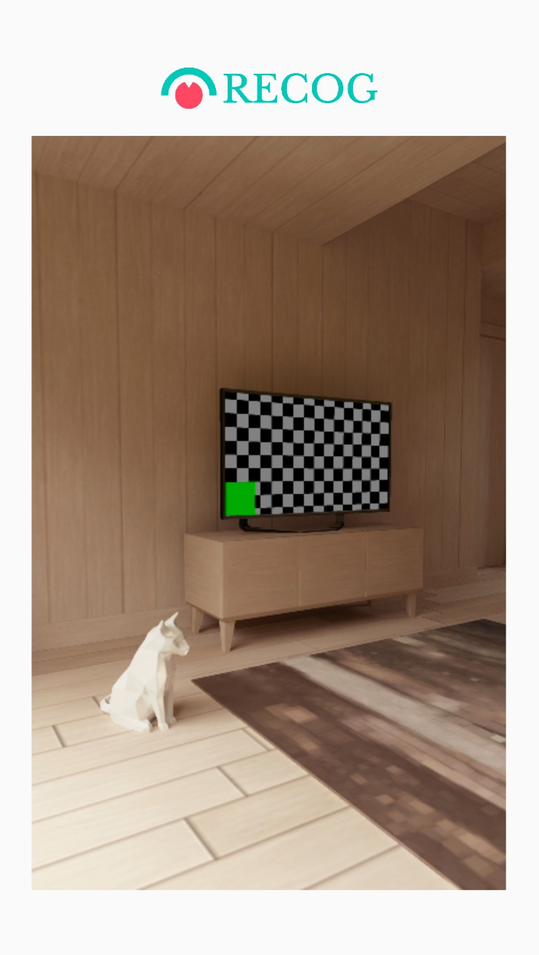
Main Screen
For the main screen we wanted an equally minimalistic design that required little to no user interaction to work.
Given that the app starts analysing the frames on its own the only thing we saw fit to include was the direct feed.

Slide 23
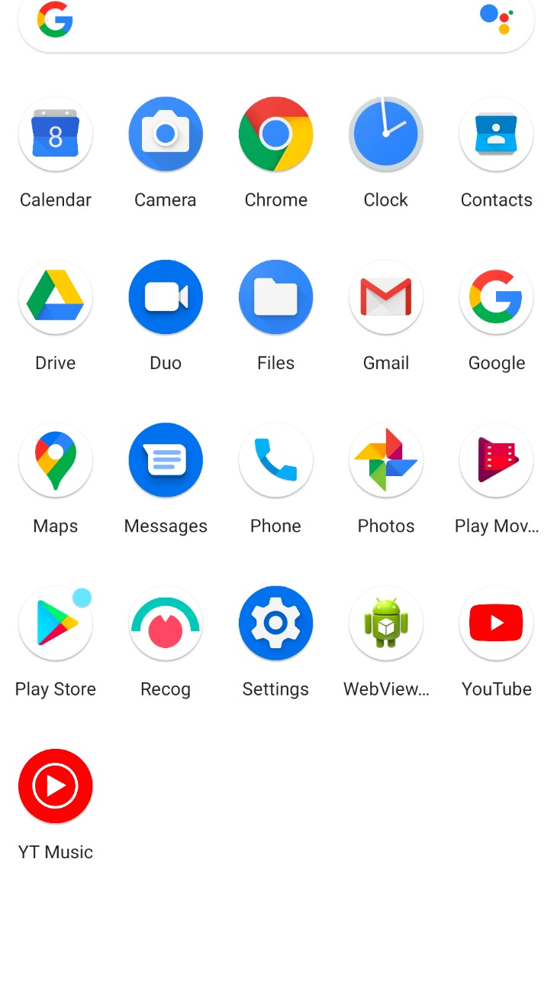
Application Logo
The colors and design of the logo were chosen to make the app more recognizable for the visually impaired.
The red in the logo portrays confidence to the user.
The design is a distinct shape where the “eyebrow” represents the 180º that it can see.

Slide 24
I believe that a simple and unassuming manner of life is best for everyone, best both for the body and the mind.
- Albert Einstein

Slide 25
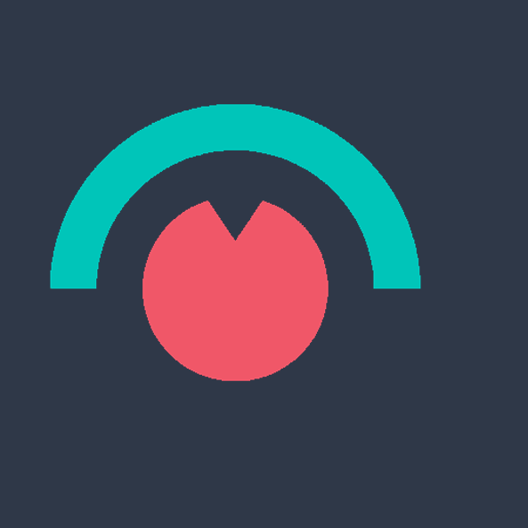
Thanks!
For a Great Semester!
You can find us on GitHub at:
@MSegimon
@jakubzolkos
@tahababou12
@AxelSariel
@JoelAkerman

